Slide 1

Worldwide Energy Consumption
Machakanti NavyaThara
Batch no : 514

Slide 2
About me
Background? (B-tech or M-tech): B-tech
Why you want to learn Data Analytics
I enjoy working with data and finding patterns that help solve problems. Data analytics
combines logical thinking, technology, and business understanding, which makes it an
interesting career for me. I like turning raw data into meaningful insights that can
support better decision-making.
Any work experience
After graduating in 2024, I worked in a non-IT role while continuously building my skills
in Python, SQL, Excel, and Power BI. This experience strengthened my communication
and problem-solving abilities and reinforced my goal of pursuing a career in Data
Analytics.
Share your LinkedIn profile URL
www.linkedin.com/in/navyathara-machakanti-713580249

Slide 3
Agenda
Business Problem
Business Problem Statement
Introduction
ER Diagram
Analysis Queries
Insights
Conclusion
Recommendation

Slide 4
Business Problem
With increasing industrialization, economic growth, and population expansion, global energy demand has risen significantly, leading to higher carbon emissions and environmental concerns.
Countries differ in their energy production, consumption, GDP, and population patterns, making it challenging to understand their impact on emissions and energy efficiency.
Therefore, there is a need to analyse global energy, GDP, population, and emission data to identify trends, compare countries, and generate insights that support sustainable energy management and environmentally responsible decision-making.

Slide 5
Business Problem Statement
With increasing energy demand and carbon emissions, there is a need to understand the relationship between energy production, consumption, GDP, population, and emissions. Using MySQL, this project analyses global energy data to identify trends, compare countries, and evaluate energy efficiency for sustainable decision-making.
SQL Techniques Used:
Joins: Combine data from multiple tables.
Aggregate Functions: Calculate totals, averages, counts, etc.
GROUP BY: Group similar records together.
ORDER BY: Sort data in a specific order.

Slide 6
Business Problem Statement
CTEs: Temporary result sets for simplifying complex queries.
Subqueries: Query inside another query.
Window Functions: Analyse data across related rows.
LAG(): Access previous row value.
FIRST_VALUE(): Get first value in a group.
LAST_VALUE(): Get last value in a group.

Slide 7
Introduction
This project focuses on analysing global energy production, energy consumption, carbon emissions, GDP, and population data using MySQL. By applying SQL concepts such as Joins, Aggregate Functions, Subqueries, Common Table Expressions (CTEs), and Window Functions, the project aims to uncover trends, compare countries, measure energy efficiency, and derive meaningful insights that support sustainable energy management and data-driven decision-making.
Datasets Used:
Country | Emission
Consumption | GDP
Production | Population

Slide 8
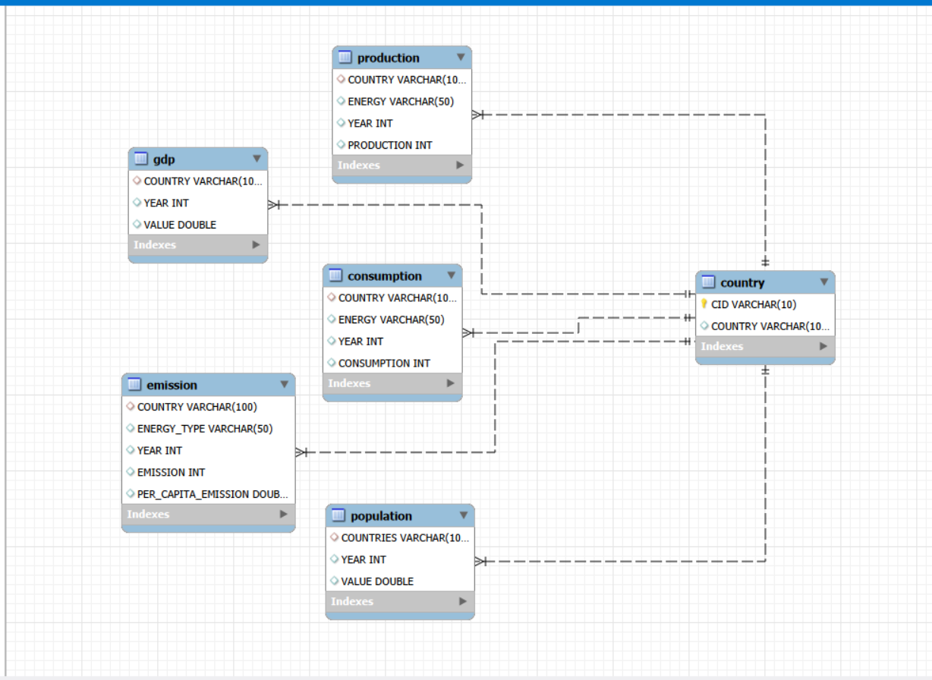
ER Diagram and Cardinality
Cardinality | Explanation
1 : M | Country to Production
1 : M | Country to Consumption
1 : M | Country to Emission
1 : M | Country to GDP
1 : M | Country to Population

Slide 9
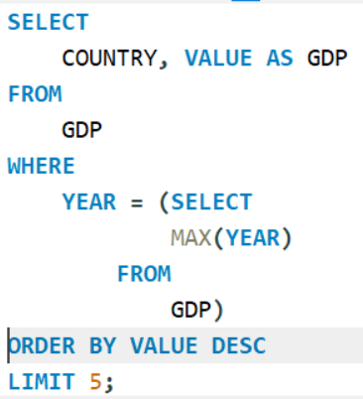
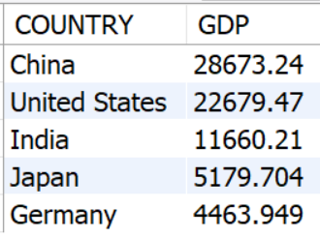
Analysis Queries
What are the top 5 countries by GDP in the most recent year?
Purpose: Compare economic strength across countries.
Insight: Understand how economic growth relates to energy usage.

Slide 10
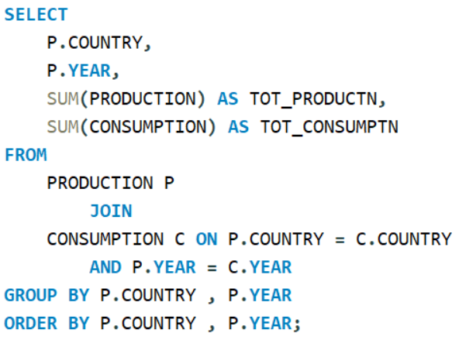
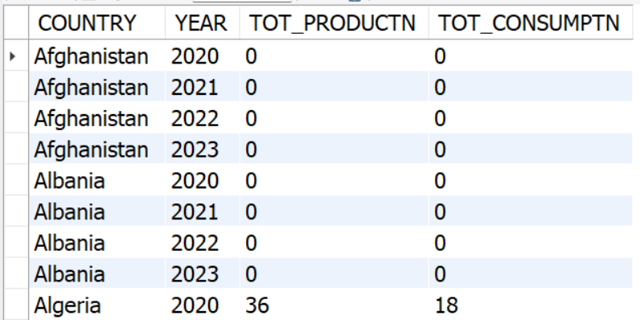
Analysis Queries
Compare energy production and consumption by country.
Purpose: Identify energy surplus and deficit countries.
Insight: Production > Consumption → Energy exporter
Consumption > Production → Energy importer

Slide 11
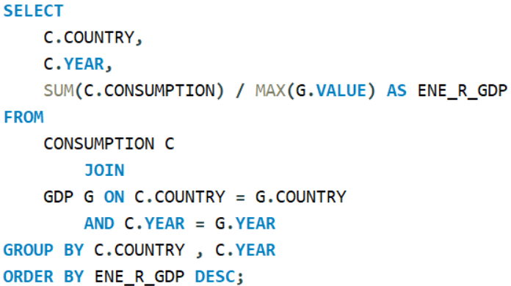
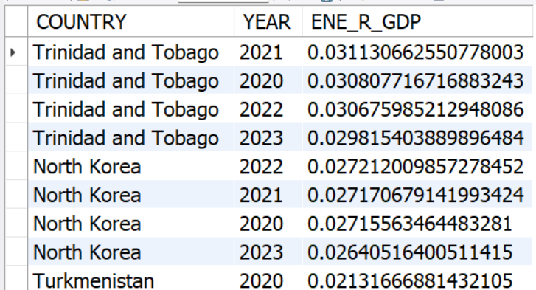
Analysis Queries
Which countries consume the most energy relative to GDP?
Purpose: Identify the largest energy consumers globally, relative to GDP.
Insight: Helps understand which countries drive global energy demand.

Slide 12
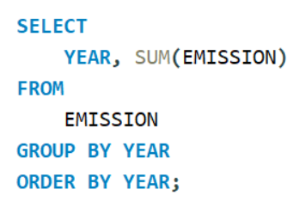
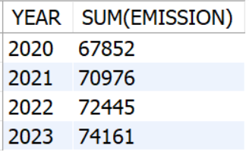
Analysis Queries
How have global emissions changed year over year?
Purpose: Analyse emission trends over time.
Insight: Determine whether emissions are increasing or decreasing globally.

Slide 13
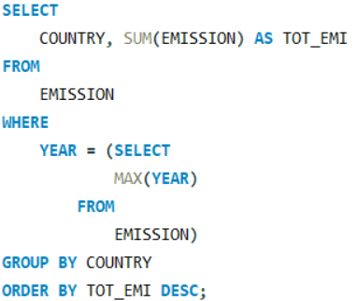
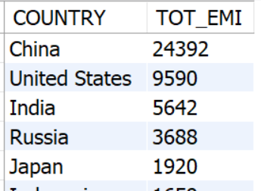
Analysis Queries
Which countries emit the most carbon?
Purpose: Identify major contributors to global emissions.
Insight: Highlights environmental impact by country.

Slide 14
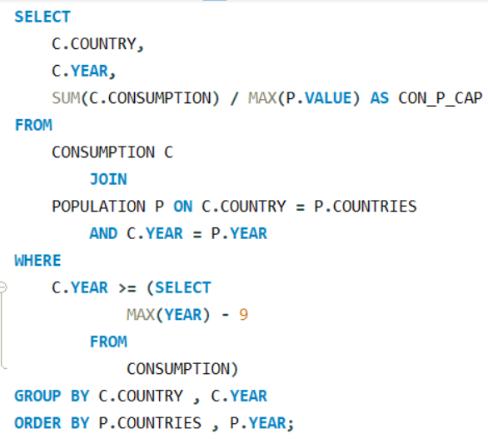
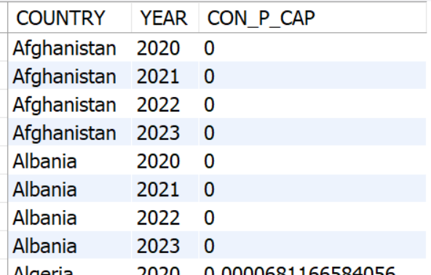
Analysis Queries
Which countries have improved (reduced) their per-capita emissions the most over the last decade?
Purpose: Identify countries becoming more environmentally efficient.
Insight: Evaluate sustainability progress.

Slide 15
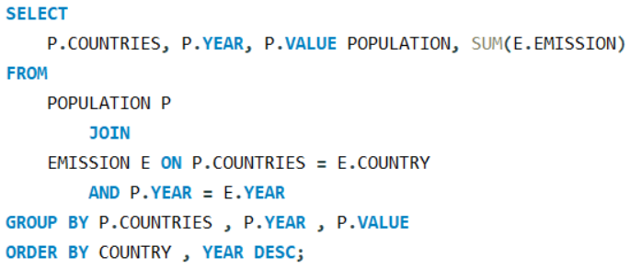
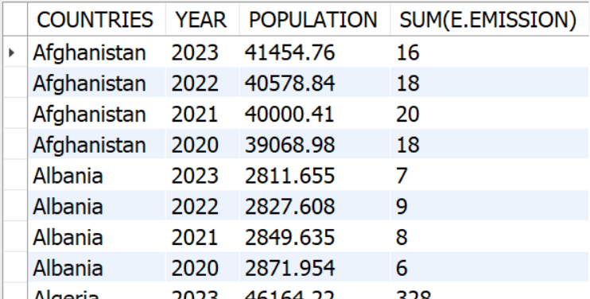
Analysis Queries
How has population growth affected total emissions?
Purpose: Examine the impact of population on environmental sustainability.
Insight: Understand whether population growth drives emissions.

Slide 16
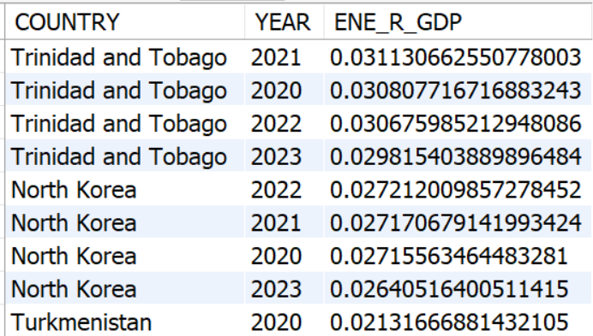
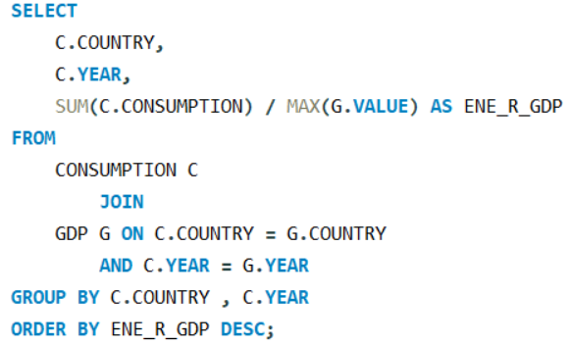
Analysis Queries
Does higher GDP lead to higher energy consumption?
Purpose: Study the relationship between economic growth and energy demand.
Insight: Determine whether richer economies consume more energy.

Slide 17
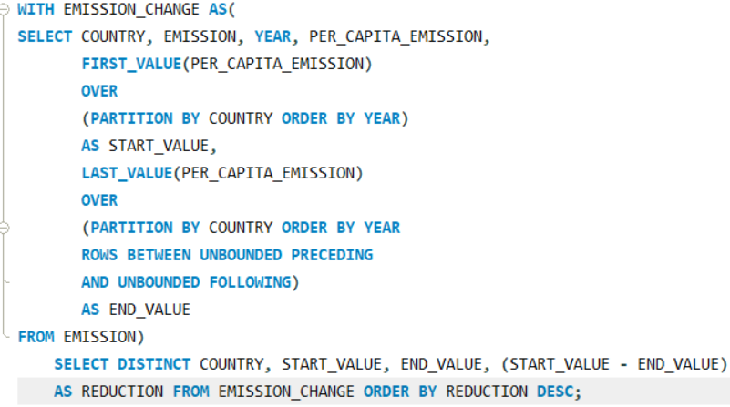
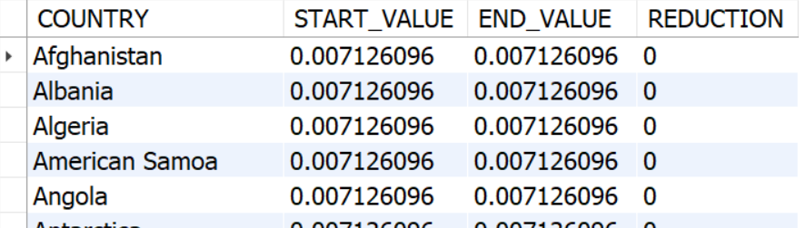
Analysis Queries
Which countries have the highest energy consumption per capita?
Purpose: Measure average energy usage per person.
Insight: Compare living standards and energy dependence.

Slide 18
Insights
Carbon emissions are concentrated in a few major economies, making them the largest contributors to global emissions.
Countries with higher GDP generally consume more energy, indicating a positive relationship between economic growth and energy demand.
Energy production and consumption differ across countries, highlighting the dependence of some countries on energy imports.
Population growth influences total emissions, but industrialization and economic activity have a greater impact.
Per-capita analysis reveals differences in energy efficiency, allowing fair comparisons between countries of different sizes.
Several countries have reduced their per-capita emissions over the available years, reflecting improvements in energy efficiency and sustainability.

Slide 19
Conclusion
Successfully analysed global energy production, consumption, carbon emissions, GDP, and population data using MySQL.
Applied SQL techniques including Joins, Aggregate Functions, Subqueries, CTEs, and Window Functions to solve real-world analytical problems.
Identified key trends, compared countries, and evaluated energy efficiency using per-capita and ratio-based analysis.
The project demonstrates how SQL can transform raw data into meaningful insights that support data-driven decision-making and sustainable energy planning.

Slide 20
Recommendation
Promote Renewable Energy: Increase the adoption of renewable energy sources to reduce carbon emissions.
Improve Energy Efficiency: Encourage efficient energy production and consumption to minimize energy wastage.
Adopt Data-Driven Policies: Use data analytics to support energy planning and environmental decision-making.
Focus on Sustainable Development: Balance economic growth with environmental protection by investing in clean technologies.
Monitor Key Performance Indicators: Regularly track emissions, energy consumption, GDP, and population trends to evaluate progress and improve energy policies.

Slide 21

THANK YOU

